Slide 1
INTRO TO HTML
MCNDHS
Ms. Eng

Slide 2
AIM: HOW ARE WEBPAGES STRUCTURED?
Do Now:
With your elbow partner, talk about a few of your favorite colors and shades and explain why you find them attractive.
Daily Grade:
On-time/attendance/not leaving the classroom: 25%
Cellphones: 25%
Notes:25%
Classwork/Homework: 25%

Slide 3
WHAT IS STRUCTURE? (I WILL GRADE)
Question: Ask yourself:
1.What is structure?
2.What are the benefits of having structure?
3.Can you think of something that has structure?

Slide 4
WHY STRUCTURE IS IMPORTANT:
USER EXPERIENCE:
1. If your site is simple to use, your client will more likely stay on the website.
2. Higher traffic.
3. Search Engine Optimization.

Slide 5
CATEGORIES OF STRUCTURE:
Front End structure: Back End structure:
*Aesthetic design *Code organization

Slide 6
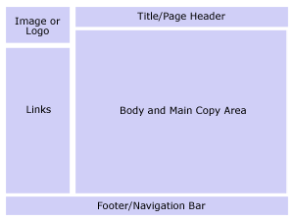
EXAMPLE OF FRONT END (PLEASE COPY)
The outside appearance

Slide 7
COMPARE AND CONTRAST
https://webpagesthatsuck.smugmug.com/Other/Bad-Web-Design/i-3gcdsKD/A
https://www.virginamerica.com/

Slide 8
A MORE CHALLENGING COMPARISON
https://www.amazon.com/gp/gw/ajax/s.html?ie=UTF8&ref_=nav_logo
http://www.ebay.com/

Slide 9
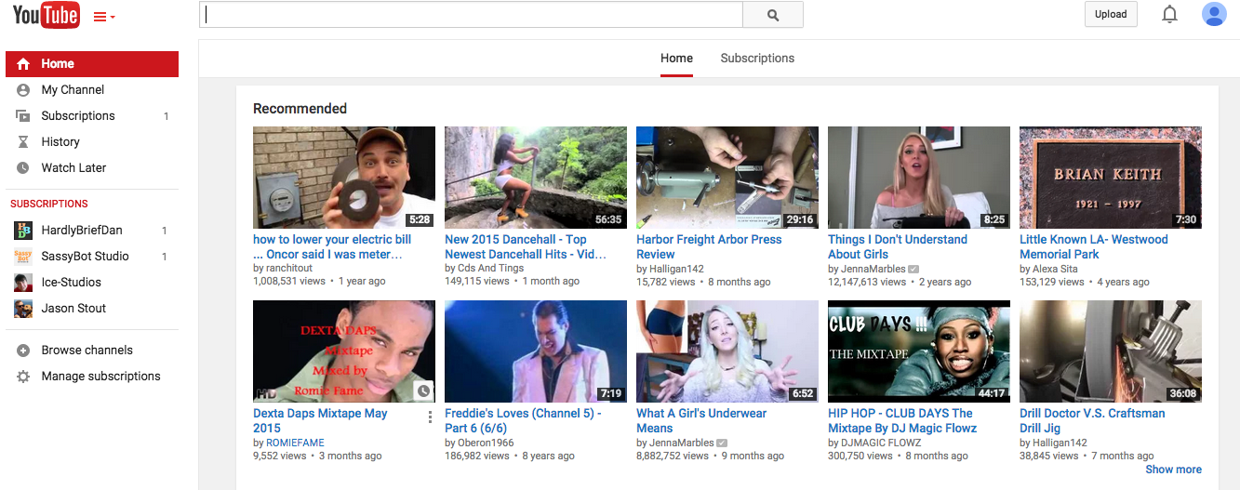
FRONT END STRUCTURE

Slide 10
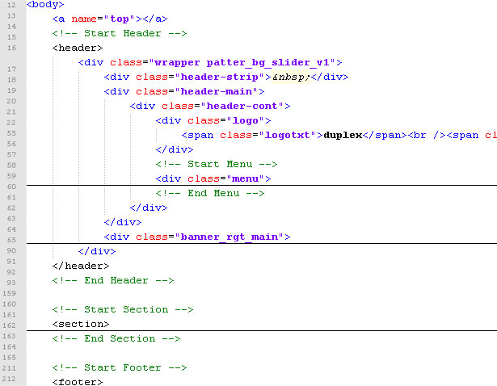
BACK END STRUCTURE
The structure of the code of a website

Slide 11
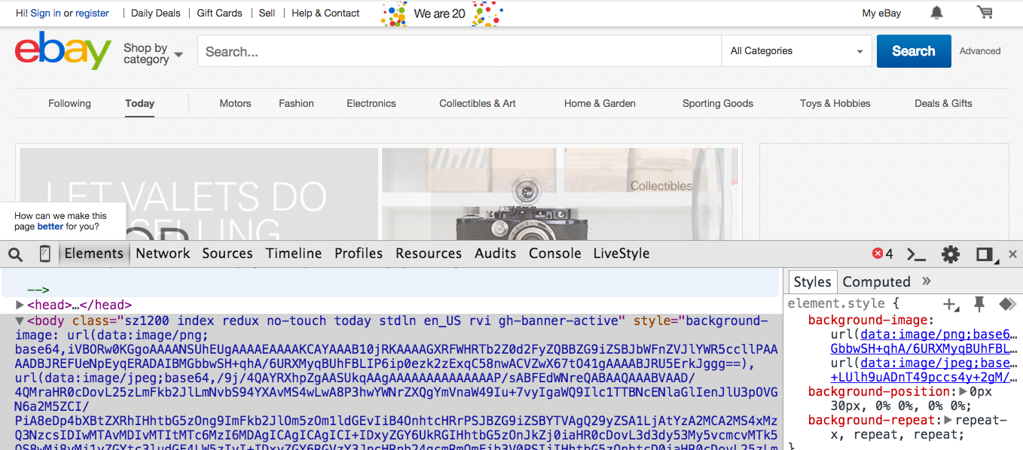
GOAL:
We want to understand the relationship between code and the physical result from it:

Slide 12
ACTIVITY
Please surf the web and find three sites and answer the following questions:
1) Give me the web address of the website.
2) Sketch the structure of the website.
3) Write three things you can improve for the websites you chose.

